Slide 1


Digital portfolio
Student name : M.Fahiya
Reg no : 24134131802522005
NMID :asanm41341324214005/
6A8B47CFD2458A3A3C446F7887CD0D3F
Department : Bsc(cs) II yr
college name : Deen college of
arts and science

Slide 2
Student's
Digital portfolio

Slide 3
Agenda
Problem statement
project overview
End users
Tools and technologies
Portfolio design and layoutout
Features and functionality
Result and screen shot
Git hub link

Slide 4
PROBLEM STATEMENT
The Traditional resume often fails to fully capture a
student's skills and project work,making it difficult for
them to stand out employers and academic institutions

Slide 5
PROJECT OVERVIEW
To Create an interactive Digital portfolio Website that allows
a Students to professionally showcase their academic
projects,technical skills and personal achievements in a
Visually appealing and Organized Manner

Slide 6
Who are the End Users?
students :
The Creators of the Portfolio,who want a professional to prevent their works
Recurites/hiring manager :
Professionals who need to quickly asseses a candidate's
abilities and project abilities
Academic Institutions :
Admission officers evaluating applicants for
graduation programs.

Slide 7
TOOLS AND TECHNIQUES
The foundational language for structuring the Portfolio
contents, including headings, Paragraphand contents
HTML :
CSS :
Used for styling the Website to control its layout,
fonts,colours and responsiveness
JavaScript :
Adds interactivity such as smooth scrolling for navigation,
Git&Github :
For Version Controlling , allowing the students to manage
project code and elaborate effectively
Deployment :
The Portfolio can be hosted for the sources like GitHub
or Netlify,making it accessyible to anyone with an
internet connection

Slide 8
PORTFOLIO DESIGN AND LAYOUT
DESIGN
Simple Colour scheme :
The Portfolio uses a limited colour palettes for aa
professional and clean look
Visual Hierarchy :
Different font sizes and weights are used to guide the
user's eye emphasize key information

Slide 9
LAYOUT
Clean, minimalist and responsive :
The Overall Layout is uncluttered and adopts well
to the different screen sizes
Header :
The Top of the page includes the student's name,a brief
tagline and a navigation bar
Dedicated section :
The Content is organized into a separate sections,
eachwith its own clear heading like "About" and "Projects"

Slide 10
FEAUTURES AND FUNCTIONALITY
FEATURES
Project showcase :
A section for students to display their works including title, description,links to
the projects and it's code
Skill Highlights:
A simple and updatable lists of technical skills
professional contact informations :
A Section with contact details and links to professional profiles like LinkedIn,
GitHub

Slide 11
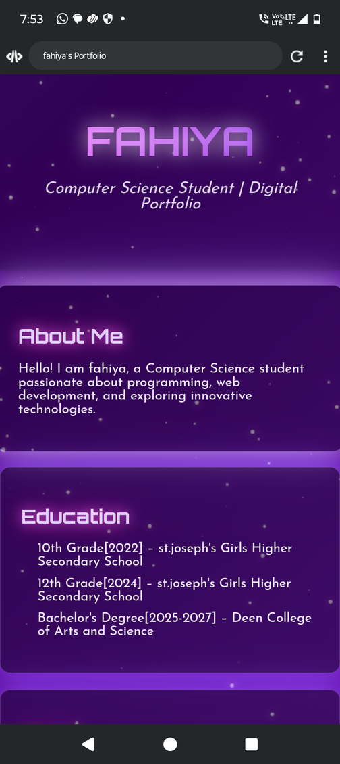
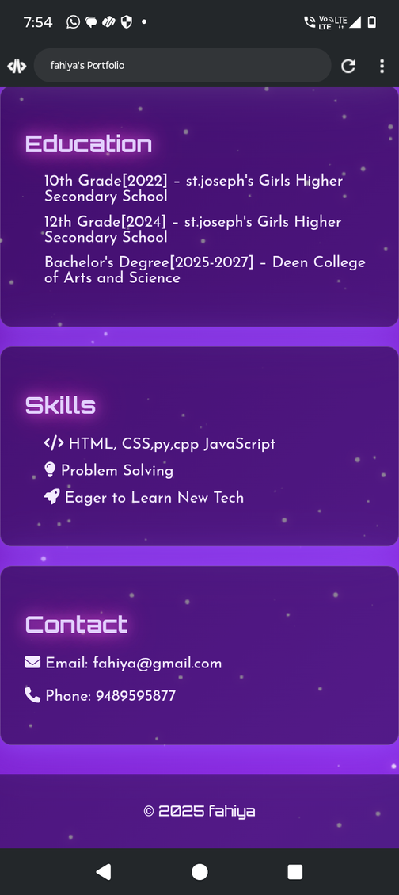

RESULTS AND SCREENSHOTS

Slide 12
FUNCTIONALITY
Interactive navigation :
The Navigation provides a smooth scrolling animation
when links are clicked, instead of an abrupt jump
Reponsiveness :
The layout adjusts to.a different screen sizes, ensuring
a good user experience on both desktop and mobile devices

Slide 13
CONCLUSION
Highlights of project :
Fahiya's Projects, a Student management system and a code editor,show
her pratical skills in both front- end and back- end development
Benifits of society :
Her Project offers a real world benefits from improving
school administration to helping programmers work more efficiently
Final summary :
This portfolio effectively proves Rafitha's potential as a software developer by
showcasing her foundationalknowledge and applied project skills

Slide 14
GITHUB LINK
https://github.com/fahiya-2331/Fahiya-TNSDC-FWD-DP.git

Slide 15
Thank you

